Slide 1


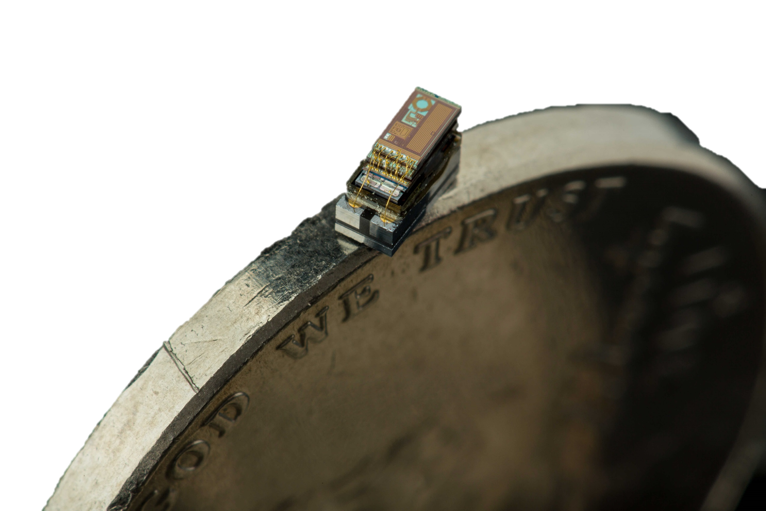
The Recent Past and Distant Future of [Micro-Scale] Embedded Systems
Pat Pannuto, University of Michigan
ppannuto@umich.edu, patpannuto.com
NextMote Workshop @ EWSN’16, Graz, Austria
February 15, 2016

Slide 2
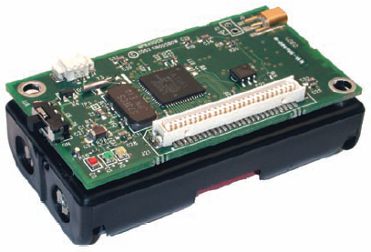
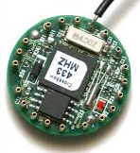
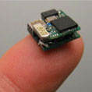
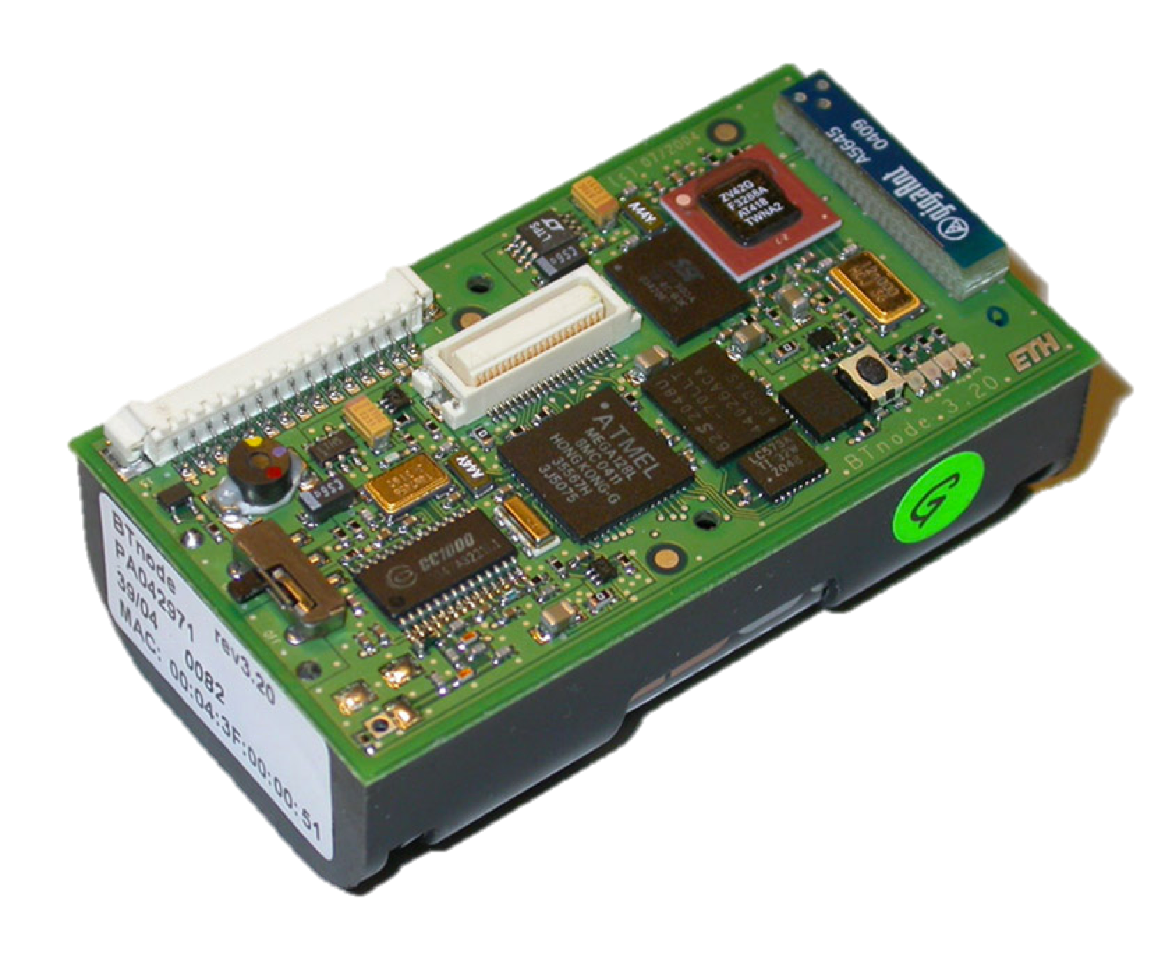
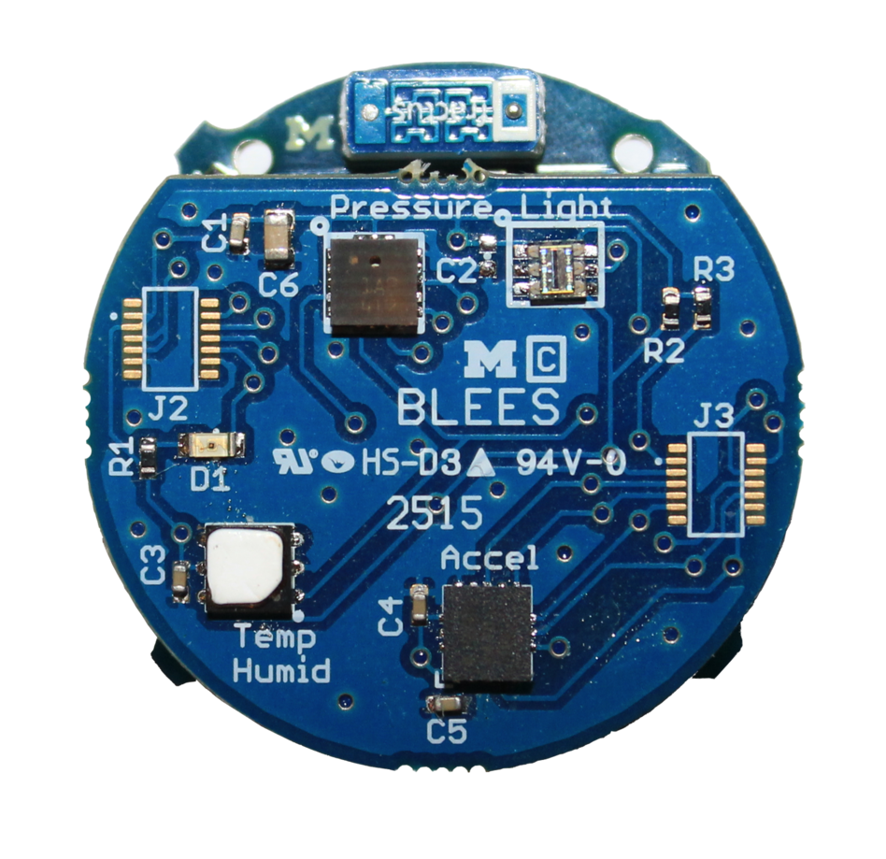
“Micro-Scale” are systems whose principle node dimension is measured on the order of millimeters
Today’s motes are decimeter-scale…
…and pushing towards centimeter-scale

Slide 3
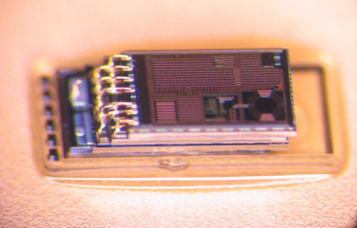
A millimeter-sized system is a 1000x reduction in volume
In practice, several nodes fit on a period.

Slide 4
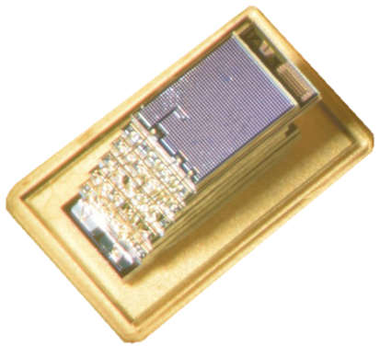
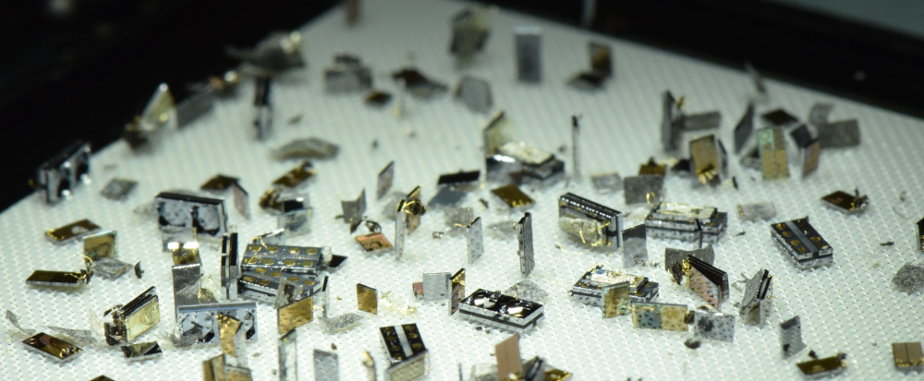
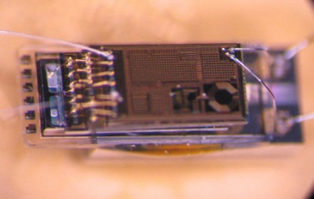
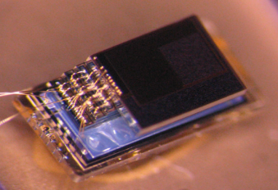
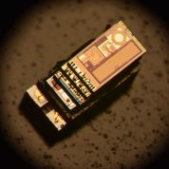
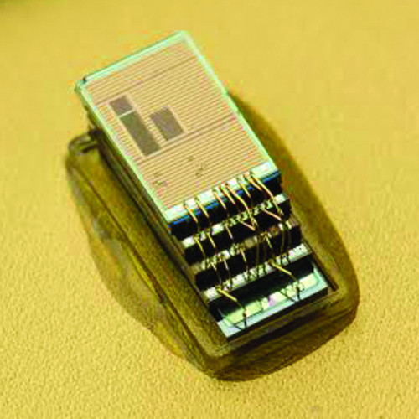
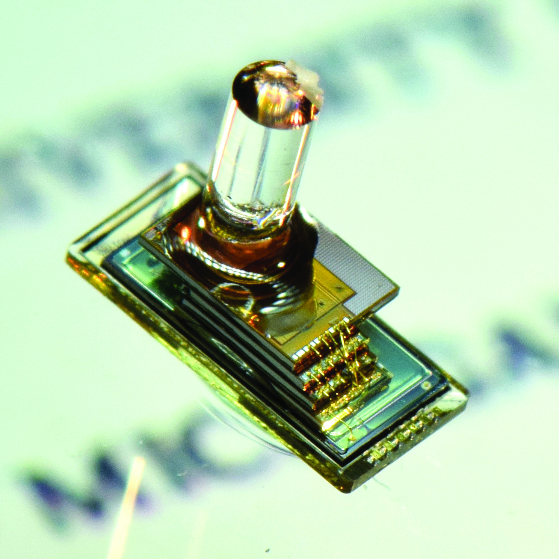
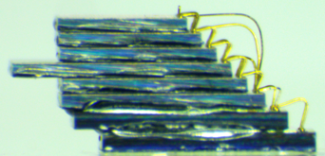
We have developed dozens of millimeter-scale motes as part of the Michigan Micro Mote (M3) project

Slide 5
This talk: A tour of micro-scale mote challenges
A Brief History of “Smart Dust”
Micro-Scale Composition Architecture
Energy
Communication
Debugging

Slide 6
This talk: A tour of micro-scale mote challenges
A Brief History of “Smart Dust”
Micro-Scale Composition Architecture
Energy
Communication
Debugging

Slide 7


“Smart Dust” is not new…
1957: Fred Hoyle’s Black Cloud
Sentient space-faring cloud organism
Early-mid 90’s: Viable?
First serious discussions at RAND and ISAT workshops
1995: Neal Stephenson’s Diamond Age
Popularized a modern vision of smart dust
1998: Kris Pister coins the term
And starts making smart dust a reality!

Slide 8
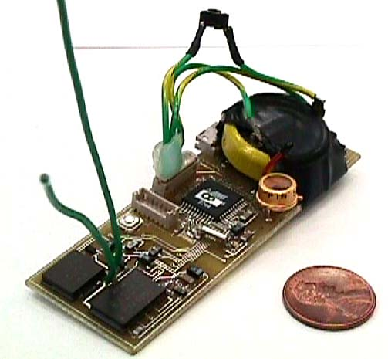
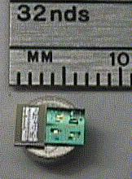
First-generation smart dust missed its 1mm³ goal, but their so-called “macro motes” were perhaps the most important
Ad-hoc composition lessened efficiency of volumetric space
Early “macro motes” dovetailed and helped drive early “mote” development
1999
900 MHz radio
Magnetometer
Accelerometer
Light
Temperature
Pressure
One week lifetime in continuous operation,
2 years w/ 1% duty cycle
http://robotics.eecs.berkeley.edu/~pister/SmartDust/

Slide 9
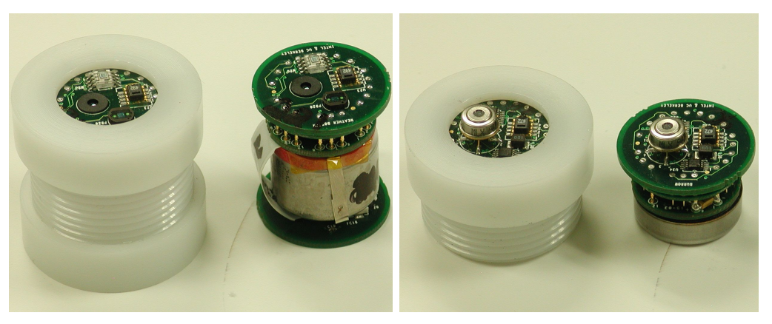
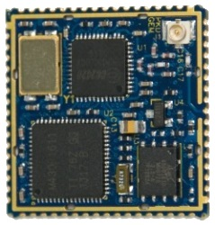
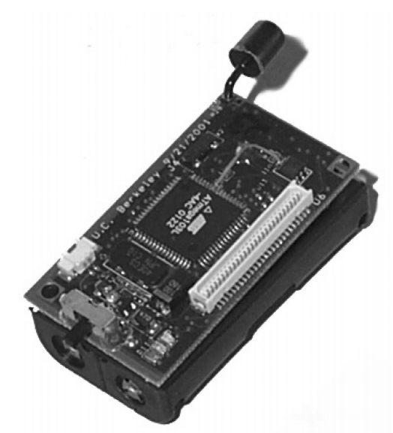
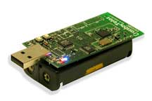
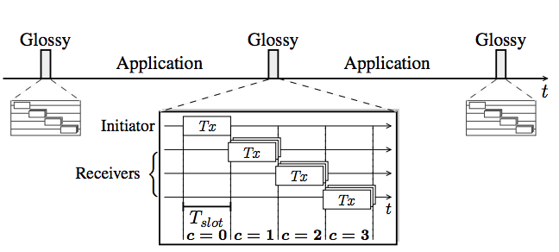
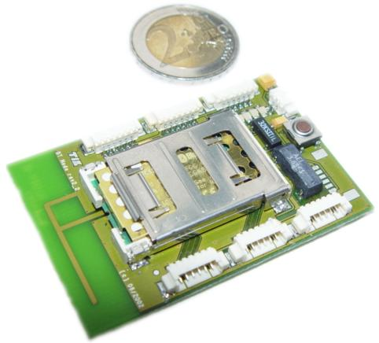
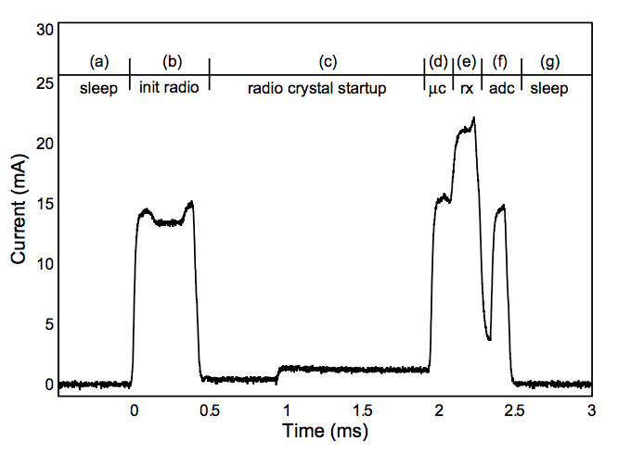
The history of modern mote research picks up around this time
CSP Workshop @ Xerox PARC
[soon to be IPSN]
Epic Core
(modular
platforms)
First MICA
Great Duck Island
TelosB
(Tmote Sky)
Workshop on Wireless Sensor Networks and Applications
[soon to be SenSys]
Glossy
BTNode
Pister & Hollar’s
“Macro Motes”
B-MAC
Notes:
Collaborative Signal Processing Workshop (CSP Workshop)

Slide 10
But what happened to research pushing towards a 1mm³ system?
?

Slide 11
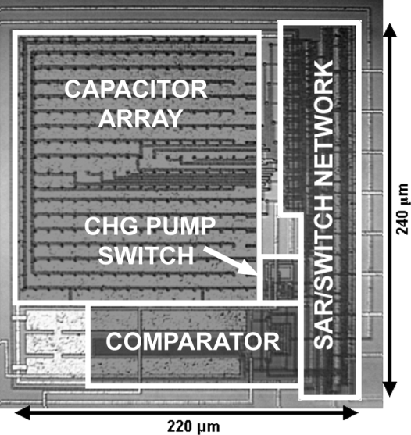
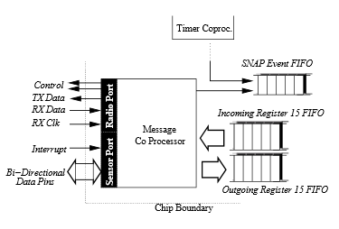
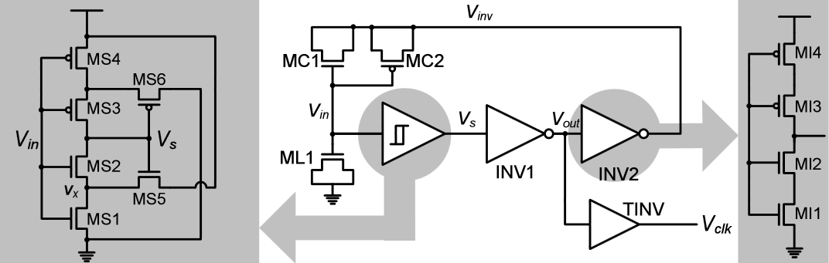
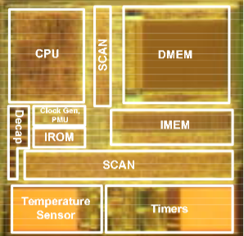
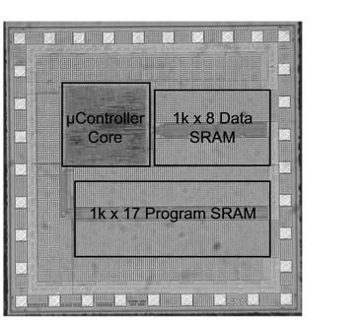
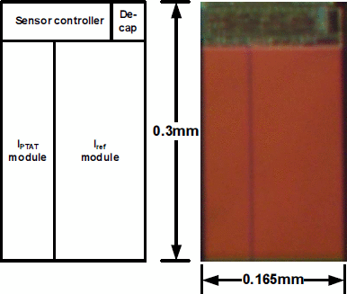
We stopped building mm-scale systems, and focused on mm-scale circuits – at least for a little while
Y.-S. Lin ‘07
V. Ekanayake ‘04
M. Scott ‘03
B. Warneke ‘04
Y.-S. Lin ‘08
2008 The Phoenix Project

Slide 12
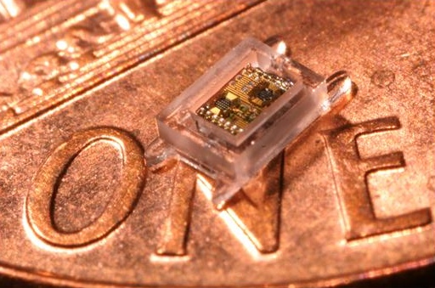
Monolithic designs let us push the envelope, but modularity must return to grow beyond a niche space
Phoenix
World’s lowest power computer (30 pW / 300 nW)
Basically a temperature sensor
Intraocular Pressure
Collaboration for glaucoma health
A pressure sensor
From mm-scale temperature sensor to mm-scale pressure sensor took 3 years
(and another half-dozen PhD students…)
2008
2011
The Phoenix Processor: A 30pW Platform for Sensor Applications, Mingoo Seok, Scott Hanson, Yu-Shiang Lin, Zhiyoong Foo, Daeyeon Kim, Yoonmyung Lee, Nurrachman Liu, Dennis Sylvester, David Blaauw , VLSI ‘08
A Cubic-Millimeter Energy-Autonomous Wireless Intraocular Pressure Monitor, Gregory Chen, Hassan Ghaed, Razi-ul Haque, Michael Wieckowski, Yejoong Kim, Gyouho Kim, David Fick, Daeyeon Kim, Mingoo Seok, Kensall Wise, David Blaauw, Dennis Sylvester, ISSCC ‘11

Slide 13
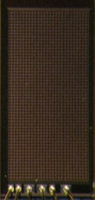
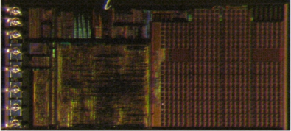
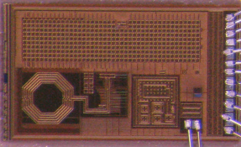
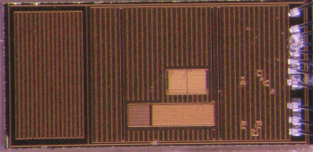
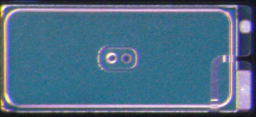
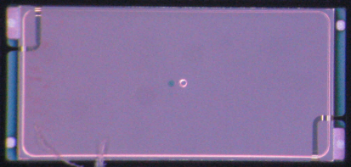
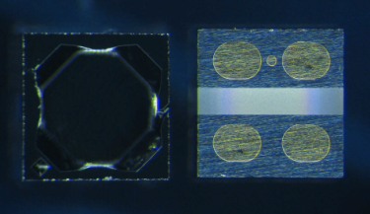
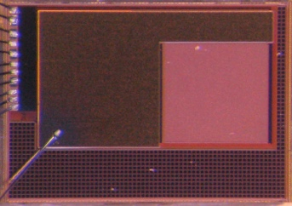
Today, we are able to mix and match components to synthesize systems
Control/
PMU
Decap
Temp Sensor
Radio
+ CDC
2 uAh Battery
5 uAh Battery
MEMS
P. Sensor
Motion Detection/ Imager
Pressure Sensing
Temp. Sensing
Visual Sensing

Slide 14

However, we had to invent a new system interconnect to be able to do it
Control/
PMU
Decap
Temp Sensor
Radio
+ CDC
2 uAh Battery
5 uAh Battery
MEMS
P. Sensor
Motion Detection/ Imager
Pressure Sensing
Temp. Sensing
Visual Sensing

Slide 15
A Brief History of “Smart Dust”
Micro-Scale Composition Architecture
Energy
Communication
Debugging

Slide 16

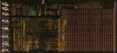
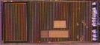
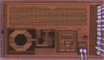
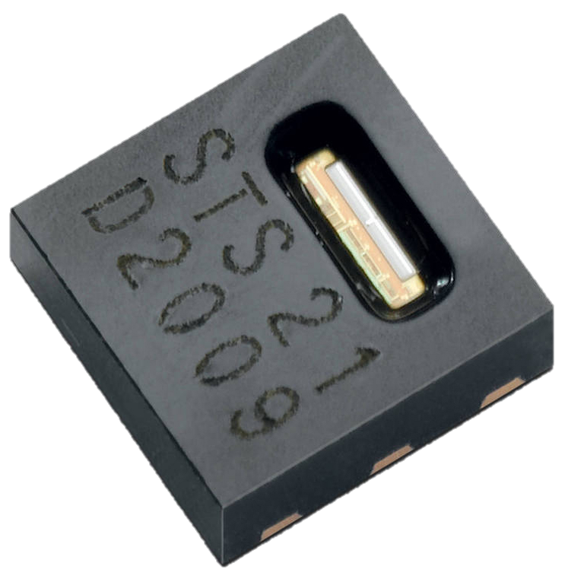
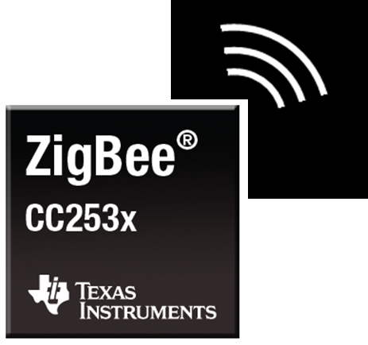
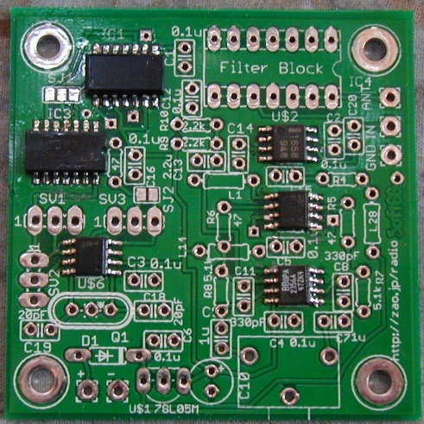
Comparing system composition strategies between traditional motes and mm-scale motes
How to build a mote to sense temperature today?
Processor
Temperature Sensor
Radio
How to build a mm-scale mote to sense temperature?
temp_sense t1 (
…
.sample_valid_out (to_proc_t1_sample_valid),
.sample_out (to_proc_t1_sample),
);
processor p1 (
…
.temp_valid_in (to_proc_t1_sample_valid),
.temp_in (to_proc_t1_sample),
);

Slide 17
We have solutions for composing embedded systems… SPI and I²C
Nearly every microcontroller has both
Nearly every peripheral has one or the other
Very few use anything else
(except maybe UART)
So why don’t they work for mm-scale systems?

Slide 18
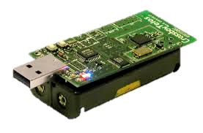
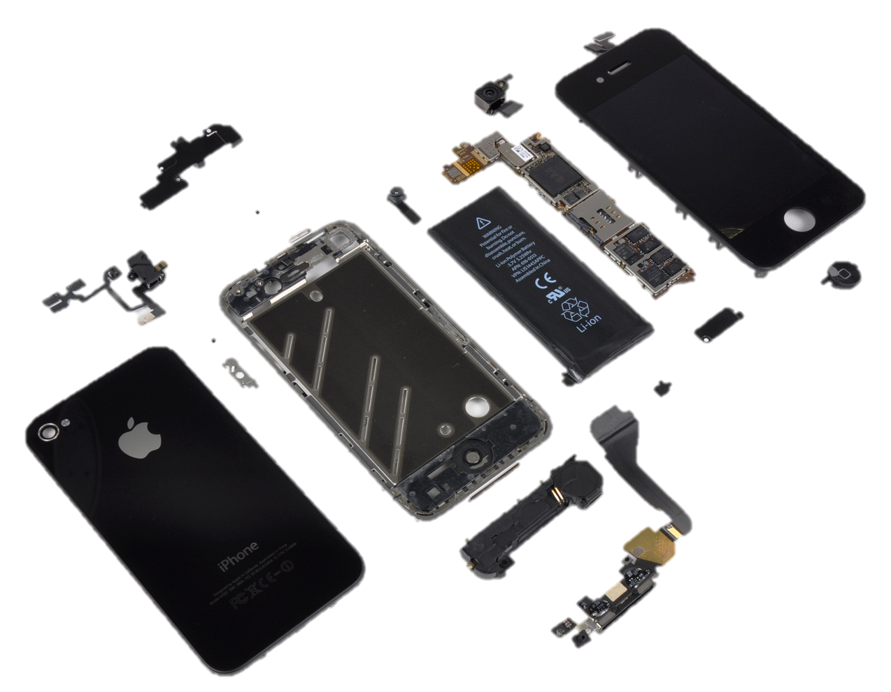
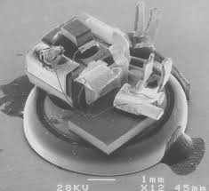
Millimeter-scale systems are small
Node volume is dominated by energy storage
And volume is shrinking cubically
“Phone”
Battery
“Sensor”
Batteries
“Sensor”
Battery
Budget 10’s μW active, 10’s nW sleep, DC 0.1%

Slide 19
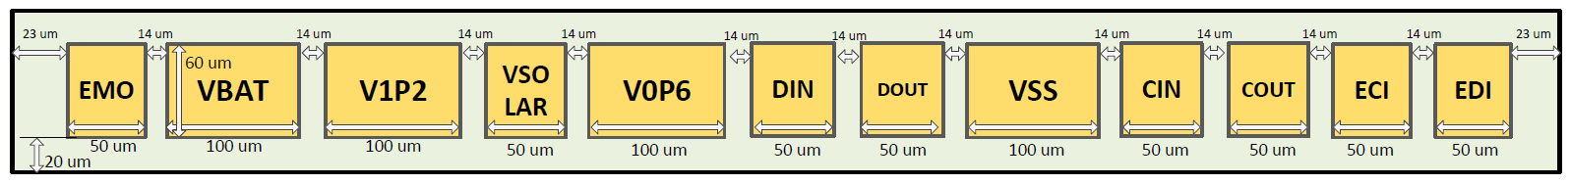
Millimeter-scale systems are small
Node volume is dominated by energy storage
And volume is shrinking cubically
I/O pads begin to account for non-trivial percentage of node surface area
“Phone”
Battery
“Sensor”
Batteries
1 mm = 1,000 μm
50 μm, minimum viable bond pad
“Sensor”
Battery
16-20 maximum I/O pins for 3D stacking
Budget 10’s μW active, 10’s nW sleep, DC 0.1%

Slide 20
What is wrong with how are systems composed today?
SPI, invented by Motorola in ~1979
One master, N slaves
Shared clock: SCLK
Shared data bus: MOSI
Shared data bus: MISO
One Slave Select line per slave
Key Properties
One dedicated I/O line per slave
Master controls all communication
Master
Slave 1
SCLK
MOSI
MISO
SS0
SS1
…
SCLK
MOSI
MISO
SS
Slave 2
SCLK
MOSI
MISO
SS
Notes:
Extremely populare; almost all MCUs have this interface

Slide 21
What is wrong with how are systems composed today?
SPI, invented by Motorola in ~1979
One master, N slaves
Shared clock: SCLK
Shared data bus: MOSI
Shared data bus: MISO
One Slave Select line per slave
One interrupt line per slave
Key Properties
One Two dedicated I/O lines per slave
Master controls all communication
Interrupts must be out-of-band
Master
Slave 1
SCLK
MOSI
MISO
SS0
SS1
…
GPIO0
GPIO1
…
SCLK
MOSI
MISO
SS
INT
Slave 2
SCLK
MOSI
MISO
SS
INT

Slide 22
SPI’s I/O overhead and centralized architecture do not scale to mm-scale systems
SPI, invented by Motorola in ~1979
One master, N slaves
Shared clock: SCLK
Shared data bus: MOSI
Shared data bus: MISO
One Slave Select line per slave
One interrupt line per slave
Key Properties
One Two dedicated I/O lines per slave
Master controls all communication
Interrupts must be out-of-band
Master
Slave 1
SCLK
MOSI
MISO
SS0
SS1
…
GPIO0
GPIO1
…
SCLK
MOSI
MISO
SS
INT
Slave 2
SCLK
MOSI
MISO
SS
INT

Slide 23
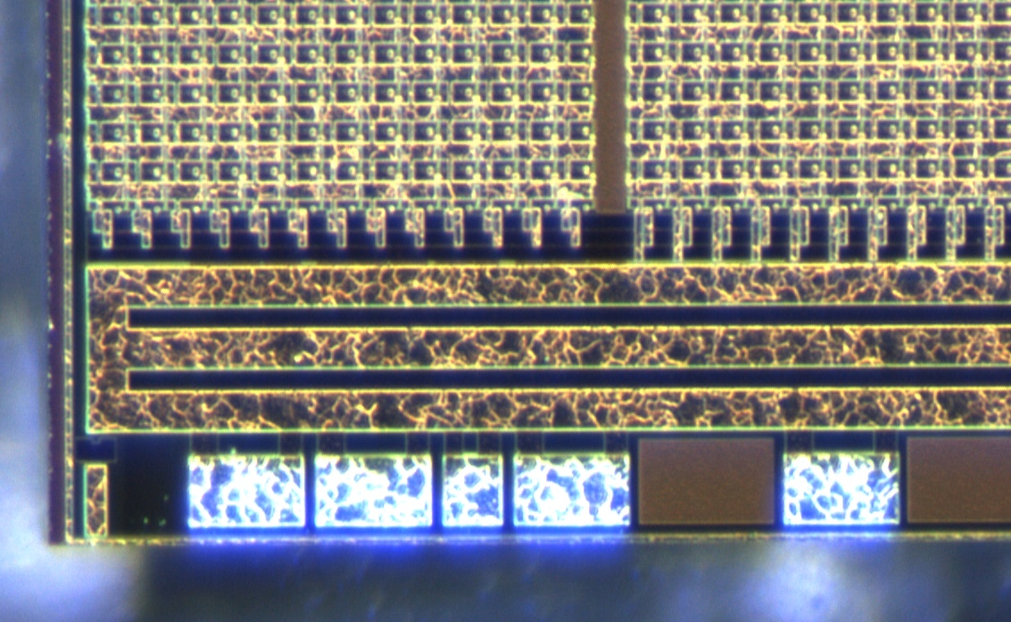
SPI’s I/O overhead and centralized architecture do not scale to mm-scale systems
SPI, invented by Motorola in ~1979
Master
Slave 1
1 mm = 1,000 μm
SCLK
MOSI
MISO
SS0
SS1
…
GPIO0
GPIO1
…
SCLK
MOSI
MISO
SS
INT
50 μm, minimum viable bond pad
Slave 2
SCLK
MOSI
MISO
SS
INT
16-20 maximum I/O pins for 3D stacking

Slide 24
I²C has fixed I/O requirements and a decentralized architecture
I²C, invented by Phillips in 1982
Any-to-(m)any on one shared bus
Key Properties
Fixed wire count (2)
Node1
Node2
Node3
SCL
SDA
SCL
SDA
SCL
SDA

Slide 25
I²C has fixed I/O requirements and a decentralized architecture
I²C, invented by Phillips in 1982
Any-to-(m)any on one shared bus
Key Properties
Fixed wire count (2)
Open-collector
Multi-master
Flow Control
Node1
Node2
Node3
SCL
SDA
SCL
SDA
SCL
SDA
Open-collector (aka wired-AND)

Slide 26
The problem is the energy costs of running an open-collector
@400 kHz
V_{DD} = 1.2 V
No setup, no hold
R = 15.5 kΩ
(“the best”)
80% V_{DD} as 1
Send a “1”: 0 J
Send a “0”: 174 pJ

Slide 27

The problem is the energy costs of running an open-collector
@400 kHz
@400 kHz
V_{DD} = 1.2 V
No setup, no hold
Bigger R?
R = 15.5 kΩ
(“the best”)
80% V_{DD} as 1
Send a “1”: 0 J
Send a “0”: 174 pJ
SCL Alone: 70 μW

Slide 28
The problem is the energy costs of running an open-collector
@400 kHz
@400 kHz
V_{DD} = 1.2 V
No setup, no hold
Active Energy Budget: 20 μW
Not an arbitrary number:
Volume Target
Lifetime Target
R = 15.5 kΩ
(“the best”)
Two batteries
80% V_{DD} as 1
Send a “1”: 0 J
Send a “0”: 174 pJ
SCL Alone: 70 μW
~ 3.1 mm

Slide 29
The energy demands of open-collectors make them unsuitable for mm-scale systems
@400 kHz
@400 kHz
Active Energy Budget: 20 μW
Not an arbitrary number:
Volume Target
Lifetime Target
Two batteries
SCL Alone: 70 μW
~ 3.1 mm
Notes:
Design for 20, try to hit 40 in practice

Slide 30
The design and synthesis of modular, millimeter-scale systems requires a new embedded interconnect

Slide 31
MBus is a clean-slate design, built to satisfy interconnect requirements for this and the next generation of motes
Fixed pin count (4)
Minimal standby and active power
Large global address space
Multi-master design
Broadcast message support
Hardware acknowledgements
Data independent behavior
Modest protocol overhead
Power aware design
MBus: An Ultra-Low Power Interconnect Bus for Next Generation Nanopower Systems
Pat Pannuto, Yoonmyung Lee, Ye-Sheng Kuo, ZhiYoong Foo, Benjamin Kempke, Gyouho Kim, Ronald G Dreslinski, David Blaauw, and Prabal Dutta
Proceedings of the 42nd International Symposium on Computer Architecture (ISCA ’15)

Slide 32
MBus in a nutshell
Ring Topology
2 lines – 4 I/O per node
Clock
Data
Transaction oriented
Arbitration
Address Transmission
Data Transmission
Interjection
Control (ACK/NAK)
“Shoot-Through”
MBus Mediator
Clock
Data
MBus Member
MBus Member
MBus Member
MBus Member
CLK_IN
CLK_OUT

Slide 33
Embedded interconnect technology has not changed in over 30 years
If we re-examine…

Slide 34
Embedded interconnect technology has not changed in over 30 years
If we re-examine…
Addressing
Requires I/O not available
Makes packaging assumptions
Systems will not always be PCBs
Routing may not be easy
3D stack
Flip-chip + TSVs

Slide 35
Embedded interconnect technology has not changed in over 30 years
If we re-examine…
Addressing
3 Options
Short static addresses and allow device conflicts
Long static addresses to avoid device conflicts
Non-static addresses
MBus does all 3
4-bit: Static short prefixes (device class)
24-bit: Static long prefixes (unique device ID)
4-bit: Runtime enumeration protocol (replaces short prefix)

Slide 36
Embedded interconnect technology has not changed in over 30 years
If we re-examine…
Addressing
Acknowledgements
I²C acknowledges every byte
How often do NAKs happen?
To a random byte?
12.5% overhead
MBus ACKs transactions
Receiver can interject message

Slide 37
Embedded interconnect technology has not changed in over 30 years
CPU
If we re-examine…
Addressing
Acknowledgements
Centralized vs Decentralized
Sensor
Radio
CPU
Sensor
Radio
Over 2x energy consumption with centralized
7% improvement in lifetime for a prototypical “sense & send” application

Slide 38
Existing interconnect technology cannot service forthcoming motes, and may be hindering current motes
Leading embedded interconnects are showing flaws
Unbounded I/O requirements
Burdensome runtime energy demands
Limited addressing schemes
Inefficient or nonexistent acknowledgments
Restrictive centralized architecture
MBus addresses all of these issues and adds new features

Slide 39
Energy is a looming system synthesis problem
A Brief History of “Smart Dust”
Micro-Scale Composition Architecture
Energy
Communication
Debugging

Slide 40
Motes embraced “dark silicon” first
Powering off regions of a chip has become commonplace
Motes power off regions of a system
Requires coordination strategy
Historically the CPU
Putting peripherals into
standby mode was good
enough for early, battery-
backed motes…
1999
900 MHz radio
Magnetometer
Accelerometer
Light
Temperature
Pressure
One week lifetime in continuous operation,
2 years w/ 1% duty cycle

Slide 41
Energy-critical systems push from “dark silicon” to “pitch black” silicon
Clock-gating
Stop driving the clock tree of regions of a chip
Eliminates switching power, but not static leakage
“Dark Silicon”
Power-gating
Switch off power to regions of a chip
Eliminates all chip leakage
“Pitch Black Silicon”
M3 systems aggressively power-gate to reach energy budget

Slide 42



Energy-harvesting motes embrace “pitch black” silicon Can we build a (useful) battery-free mote? Mote platform?
“The Nuclear Option”
Zero static leakage
Very little control
Slide borrowed from Prabal Dutta
L. Yerva, B. Campbell, A. Bansal, T. Schmid, and P. Dutta, “Grafting Energy-Harvesting Leaves onto the Sensornet Tree,” In Proceedings of the 11th International Conference on Information Processing in Sensor Networks (IPSN'12), Beijing, China, Apr. 16-20, 2012.

Slide 43









Monjolo sensors—the harvester is the sensor
L. Yerva, B. Campbell, A. Bansal, T. Schmid, and P. Dutta, “Grafting Energy-Harvesting Leaves onto the Sensornet Tree,” In Proceedings of the 11th International Conference on Information Processing in Sensor Networks (IPSN'12), Beijing, China, Apr. 16-20, 2012.
Samuel DeBruin, Bradford Campbell, and Prabal Dutta, "Monjolo: An Energy-Harvesting Energy Meter Architecture,” In Proceedings of the 11th ACM Conference on Embedded Networked Sensor Systems (Sensys'13), Rome, Italy, Nov. 11-14, 2013.
Monjolo: A Portuguese water hammer
Hammer rate ⬄ flow rate
Fixed water quanta / strike
Non-linearity with high flow rate
B. Campbell, B. Ghena, and P. Dutta, "Energy-Harvesting Thermoelectric Sensing for Unobtrusive Water and Appliance Metering,” In Proceedings of the 2nd International Workshop on Energy Neutral Sensing Systems (ENSsys'14), Memphis, TN, Nov. 6, 2014.
Slide borrowed from Prabal Dutta

Slide 44

The Monjolo principle decomposes into an array of components that build a diverse set of energy-harvesting sensors
HW/SW designs available online:
[1] http://lab11.eecs.umich.edu/pcb.html
[2] https://github.com/lab11
Slide borrowed from Prabal Dutta

Slide 45



Systems are not required to be all or none, however
“Federated Energy”
Harvest an independent store for each component
Completely cut power when component is not in use
But this system cannot cut power to the MCU
MCU-Federated energy control
Josiah Hester, Lanny Sitanayah, and Jacob Sorber. 2015. Tragedy of the Coulombs: Federating Energy Storage for Tiny, Intermittently-Powered Sensors. In Proceedings of the 13th ACM Conference on Embedded Networked Sensor Systems (SenSys '15)

Slide 46
Embedded interconnect technology has not changed in over 30 years
If we re-examine…
Addressing
Acknowledgements
Centralized vs Decentralized
Peripheral power state is an interconnect concern

Slide 47
Our mm-scale systems leverage decentralized, autonomous power management via MBus
Key Challenges
Energy efficient multi-master systems are a distributed state problem
Cold-booting silicon is a hard circuits problem
Because there is no stable clock
MBus Key Observation
A component is either already on, or can leverage an incoming message to wake itself

Slide 48

MBus introduces three, transparent, hierarchical power domains to maximize efficiency
Provide an “always-on” abstraction
Interconnect fabric powers on components upon receipt of a message
Transparent to callers and chip designers

Slide 49
As motes continue to push the boundaries of lifetime, harvesting, and volume, every microjoule is precious
Circuits advancements will continue to provide benefits
Non-volatile RAM will fall in price and area
Accelerators will replace compute-intensive tasks
Finer-grained internal power-gating
Diminishing returns…
But there are system-level constructs wasting energy today
Leveraging peripheral power-gating
Coalescing wakeups
Clock domain controls
…

Slide 50
A Brief History of “Smart Dust”
System Composition Architecture
Energy
Communication
“Internal”
“External”
Debugging

Slide 51
Embedded interconnect protocols have not changed in 30 years either
In fact, they do not exist at all
Q: How do you read a register on a sensor?
Q: How do you write to a radio’s packet buffer?

Slide 52
MPQ: A (mostly) PHY-independent protocol to standardize reading and writing registers and memory
Motivations
Simplicity across the ecosystem
Enabling reliable direct peripheral communication
Transition CPU from active overseer to passive coordinator
Configure all peripherals at boot, then power off self
Distributed equivalent of many COTS chips (Sleepwalking, uDMA, etc)
Primitives
Read/Write Register
Block DMA transfer
“Streaming” memory

Slide 53


MPQ repurposes the 4 LSB of the address as a function identifier
Could also use the first 4 bits of data if address bits are unavailable
Embedded write addresses for read commands enable powerful command synthesis

Slide 54
An interesting quirk begets an interesting question
M3 CPU chip has only SRAM
Loses state (and programming) on complete power loss
Separate flash chip programs CPU on boot
Actually, it is a state machine issuing arbitrary DMA messages
No CPU needed for a sense, send, and forget application
As peripherals become more capable, what is the role of the CPU?

Slide 55
Perhaps it is time for a generic protocol on top of major embedded buses
Improve the programmability and utility of mostly-fixed-function peripheral frontend
Proving powerful for synthesis in M3 ecosystem
Easy to phase-in
No backward compatibility because there’s nothing today!

Slide 56
A Brief History of “Smart Dust”
System Composition Architecture
Energy
Communication
“Internal”
“External”
Debugging

Slide 57


Q: How do you program a 1mm³ mote?
Actual size

Slide 58

A 695 pW, always-on visible light communication receiver

Slide 59

A sub-nanowatt receiver opens interesting possibilities for traditional motes
Idle listening dominates energy budget of many MACs
Can we decouple synchronization from communication?
Staying Synchronized
Guard
1200 μs
@ 2ppm
Local time
Static Power:
~100 nW
300 s
Real time

Slide 60
All this begs the question, what else can we do with an intelligent lighting infrastructure?
System Architecture Directions for a Software-Defined Lighting Infrastructure
Ye-Sheng Kuo, Pat Pannuto, and Prabal Dutta
1st ACM Workshop on Visible Light Communication Systems (VLCS ’14)

Slide 61


The capabilities of VLC receivers vary greatly
Diffusing (single photodiode)
Simpler devices
→ Less computation capability
Cannot distinguish transmitters
Requires temporal signal diversity
Array (multiple photocell)
Can distinguish transmitters
Temporal or spatial diversity

Slide 62

Luxapose: Astral navigation with smart phones and smart lights
Luxapose: Indoor Positioning with Mobile Phones and Visible Light (MobiCom’14)
Ye-Sheng Kuo, Pat Pannuto, Ko-Jen Hsiao, and Prabal Dutta

Slide 63


Luxapose enables high-fidelity indoor localization with impending infrastructure
Human Perception
Decimeter-level accuracy
Unmodified smartphones
Trivially modified LED lights
Camera Perception
Luxapose: Indoor Positioning with Mobile Phones and Visible Light (MobiCom’14)
Ye-Sheng Kuo, Pat Pannuto, Ko-Jen Hsiao, and Prabal Dutta

Slide 64

Can smart dust and smart phones co-exist on the same lighting infrastructure?

Slide 65

With sufficient synchronization, transmitted signals can constructively interfere

Slide 66
Emerging non-traditional (non-narrowband RF) communication technologies are just beginning exploration
Sub-nanowatt VLC receivers
VLC retroreflectors for bi-directional communication
Acoustic?
Vibratory?
Backscatter communication
High-fidelity localization with UWB
For almost no power with backscattered UWB?

Slide 67
A Brief History of “Smart Dust”
System Composition Architecture
Energy
Communication
Debugging

Slide 68



An open question: How to effectively debug a system you cannot touch?
Debug chips provide some introspection
Snoop (or inject) on system bus
Power traces remarkably effective
Encapsulated systems remain a big issue
Bottom View: MEMS pressure sensor
Side View: Light-blocking epoxy
Top View: Clear epoxy for harvesting

Slide 69
Many further questions in this space for future motes
When is an energy harvesting node dead or just harvesting?
How to debug 1,000 nodes?
How to find “the” bad node among 1,000?
How to collect and recover failed nodes?
Or is it really just dust? ☺

Slide 70
Everyone’s favorite debugging answer: Write something well enough that it won’t crash!
A teaser for Tock
New embedded operating system
Collaboration with Stanford and UC Berkeley
Defense-in-depth: language (Rust) and hardware (MPU) protections
It’s time for proper kernel/application separation
Even viable for micro-scale processor (currently M0, but M0+ has MPU)
And a safe, accessible user-space runtime (Lua)

Slide 71
What have we learned from the development of millimeter-scale systems?
Existing system synthesis technologies cannot scale
Revisiting long-standing architectural components can yield unforeseen benefits
To maximize energy efficiency, power-awareness must permeate every aspect of the system design
New communication technologies are setting up major architectural shifts
There is lots of work yet to do!

Slide 72
http://mbus.io http://github.com/mbus http://lab11.eecs.umich.edu http://github.com/lab11
Pat Pannuto, University of Michigan
ppannuto@umich.edu, patpannuto.com

Slide 73



Gartner Hype Cycle
Appeared 2013, fell off 2014, back in 2015
[2013]: http://www.gartner.com/newsroom/id/2575515
[2014]: http://www.gartner.com/newsroom/id/2819918
[2015]: http://www.gartner.com/newsroom/id/3114217

